Slide 1
(May 17, 2017)
Autoencoding beyond pixels using a learned similarity metric
Cheng Jianlin

Slide 2

Outline
I. Introduction
II. Autoencoding with learned similarity
III. VAE/GAN
IV. Results

Slide 3
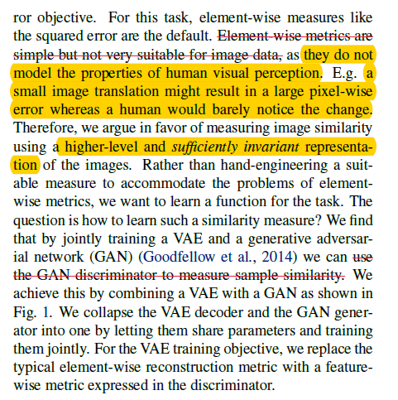
I. Introduction

Slide 4
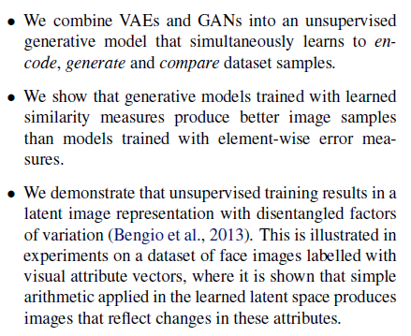
I. Introduction
Contributions

Slide 5
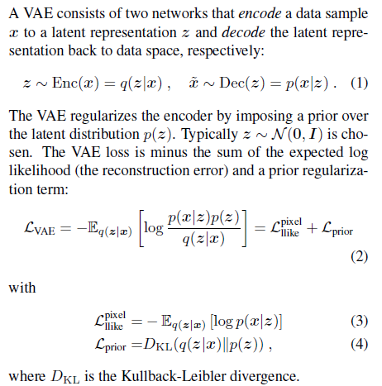
II. Autoencoding with learned similarity
Variational autoencoder

Slide 6
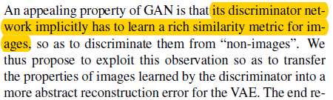
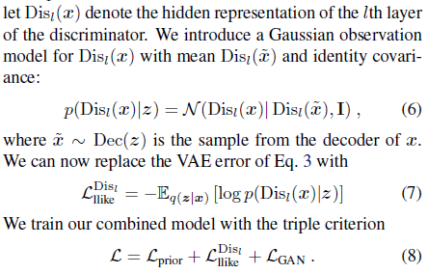
II. Autoencoding with learned similarity
Beyond element-wise reconstruction error with
VAE/GAN

Slide 7
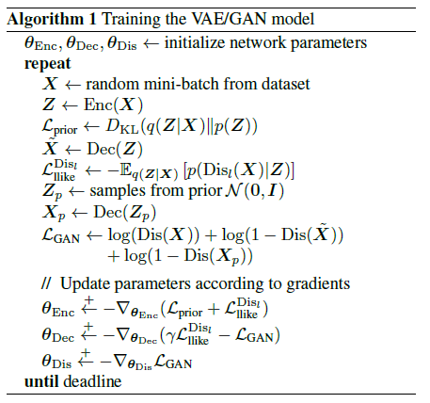
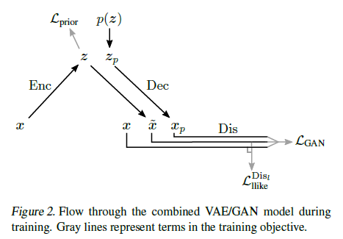
III. VAE/GAN
Autoencoding with learned similarity

Slide 8
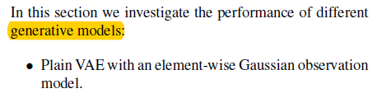
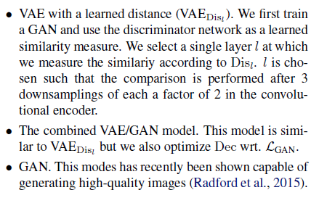
IV. Results

Slide 9
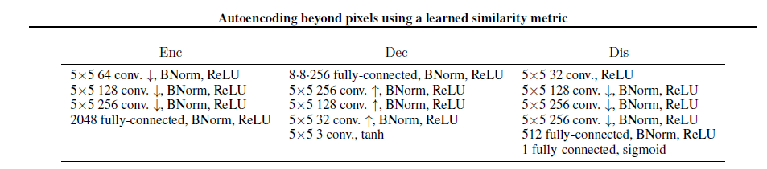
IV. Results
Notes:
判别器所近似的Wasserstein距离与生成器的生成图片质量高度相关。

Slide 10
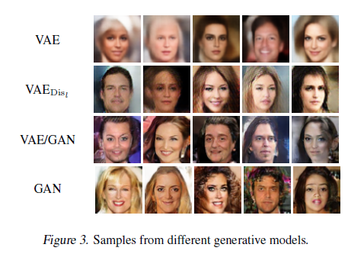
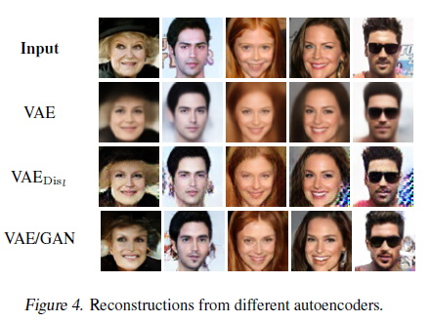
IV. Results

Slide 11
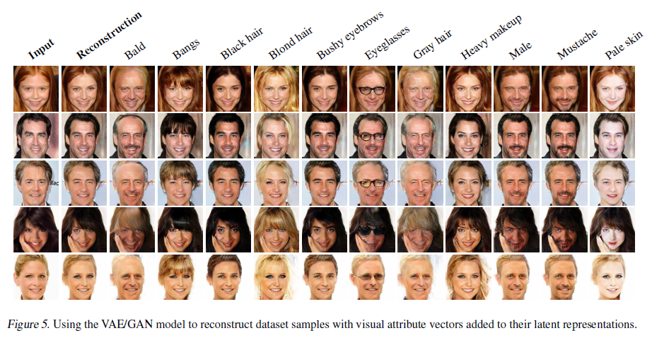
IV. Results

Slide 12
Bibliography
[1] Autoencoding beyond pixels using a learned similarity metric
[2] Auto-Encoding Variational Bayes

Slide 13

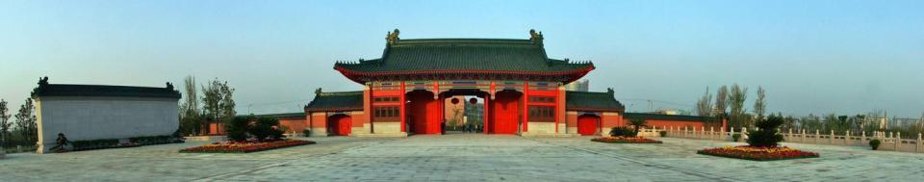

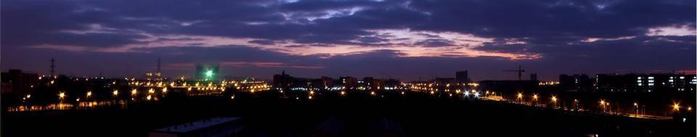
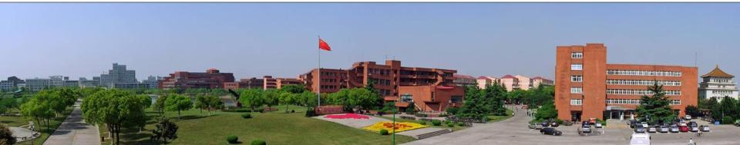
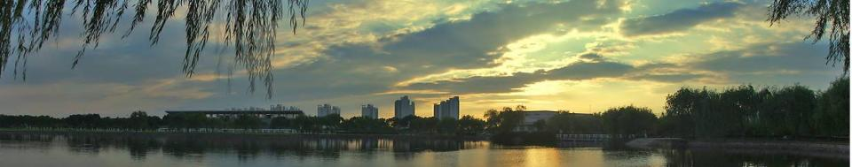
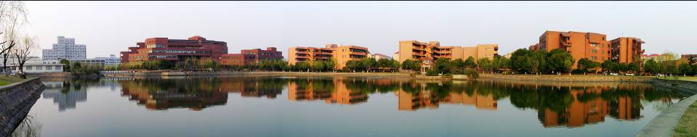
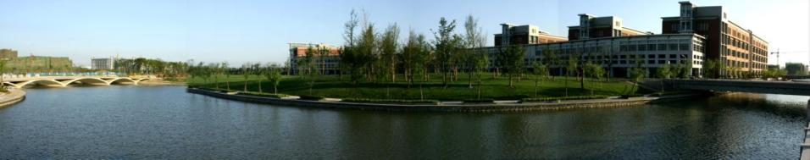
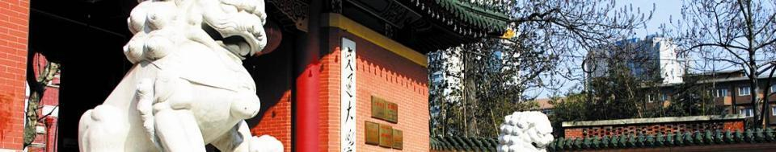
Thanks！

